Slide 1
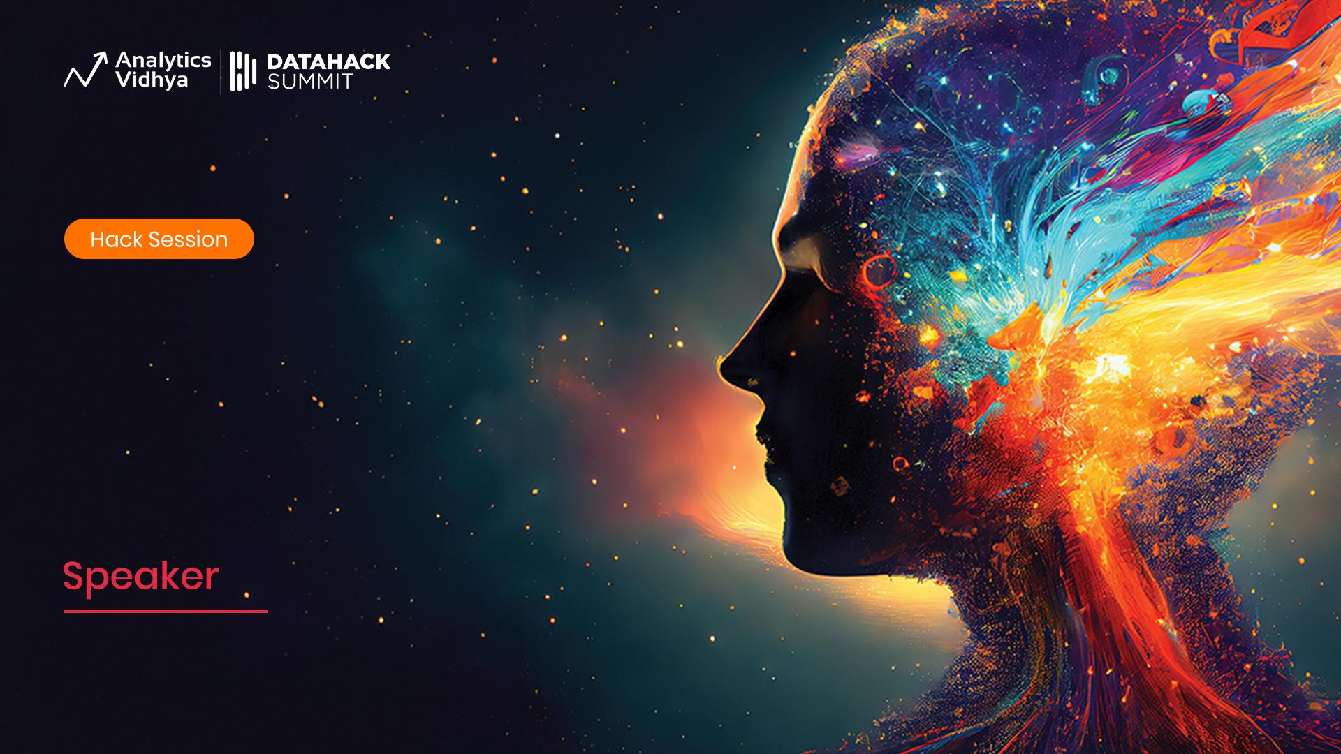

Workshop
Mastering Stable Diffusion
Module 3
Stable Diffusion in Practice, Industrial Methods
Sandeep Singh
Head of Applied AI, Beans AI

Slide 2

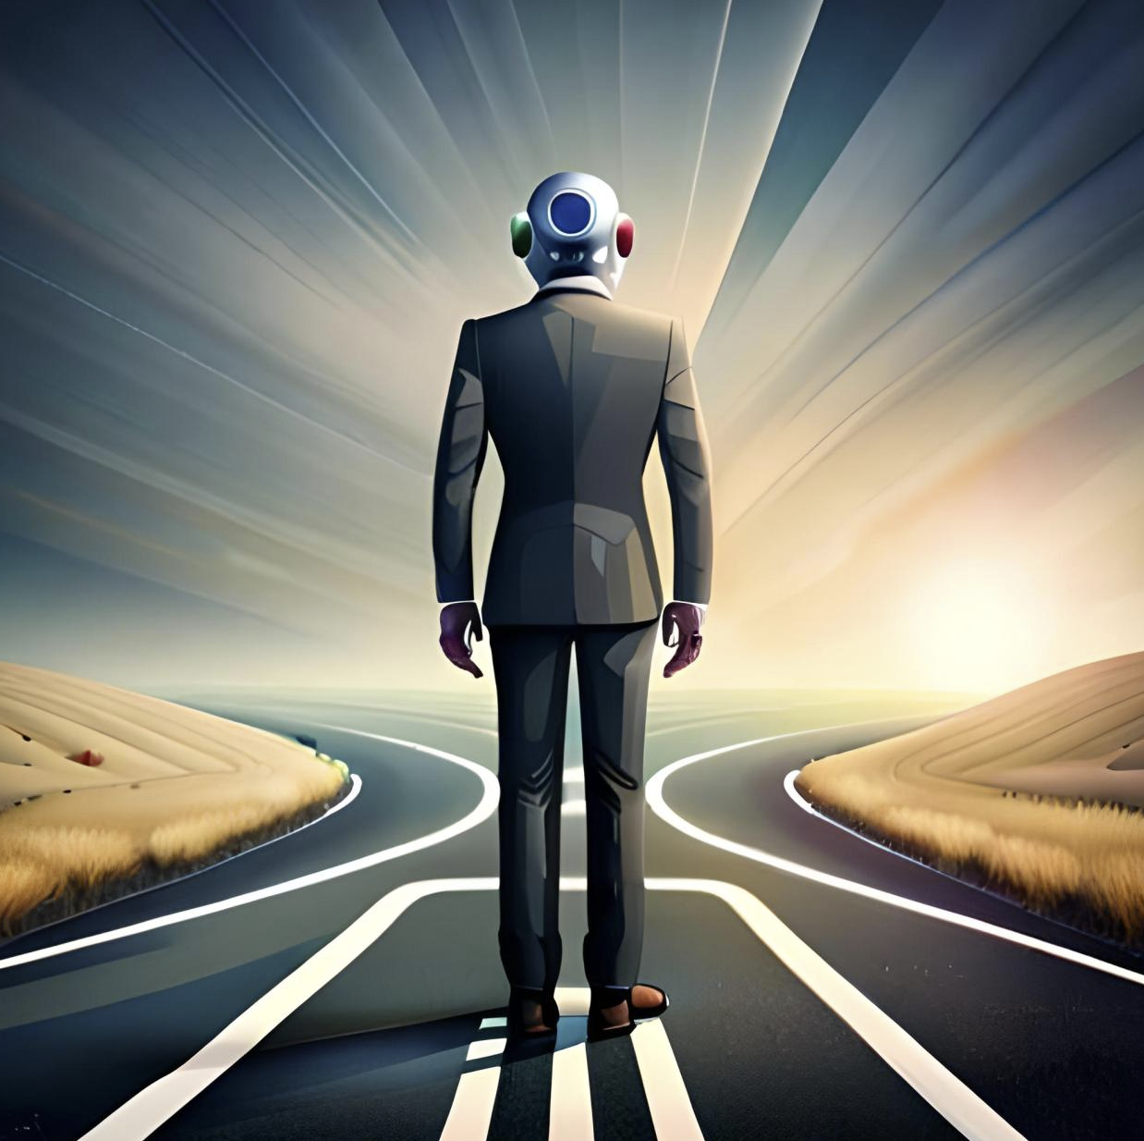
Got the Diffusion Mode, Now What?
Ok, got the diffusion Model. I can training a model to convert random noise into images of intent. Not what?
What is missing from Text-to-Image Stable Diffusion Model?
The Text
Let’s see what we need to Text-Condition the Diffusion Model.

Slide 3


Module 3 Purpose
Understand The Text Conditioning Process..
Figure out the Inspiration of Text Condition
Dall-E2 Process: Clip ⇒ GLIDE
Understand papers: CLIP GLIDE Dall-E2
Training Stable Diffusion at Scale.
Understand Important Terminologies.
Setup Hands on Stable Diffusion Code base.
Experiment with Hugging Face Diffusers Model.
OpenAI CLIP

Slide 4
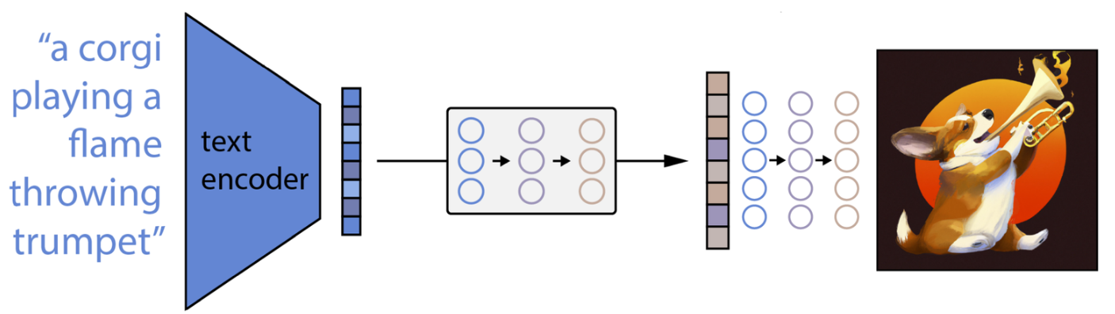
Dall-E2: 10000 Ft View
Enter Text Description to generate Images.
Text in Encoded into Text Embedding and processed further by pipeline models.
There are more than 1 internal pipeline models, which work together. No Monolithic trained!
What is in orange and blue shapes? Any guesses?
Orange Shape is: Model called Prior(which converts Text into Text Embedding. Blue Shape is: Diffusion Model(which we learned in last module)
So, we will learn about Orange Shape(Text Encoder) now!

Slide 5
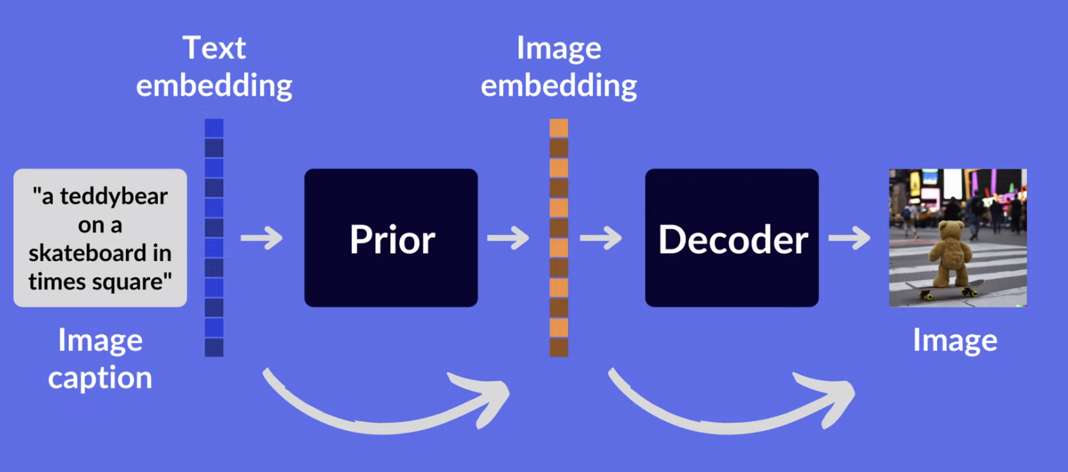
Dall-E2: 100 Ft View
Prior and Decoder both are Diffusion Models. Prior can be Autoregressive model as well, but Diffusion Model works better. We will see what it means in a bit!
DALL-E 2's works as:
First, a text prompt converted to Text Embedding via trained Text Encoder.
Next, a model called the prior maps the Text Embedding to a corresponding Image Encoding that captures the semantic information of the prompt contained in the text encoding.
Finally, an image decoder(which is diffusion model) stochastically generates an image which is a visual manifestation of this semantic information.

Slide 6
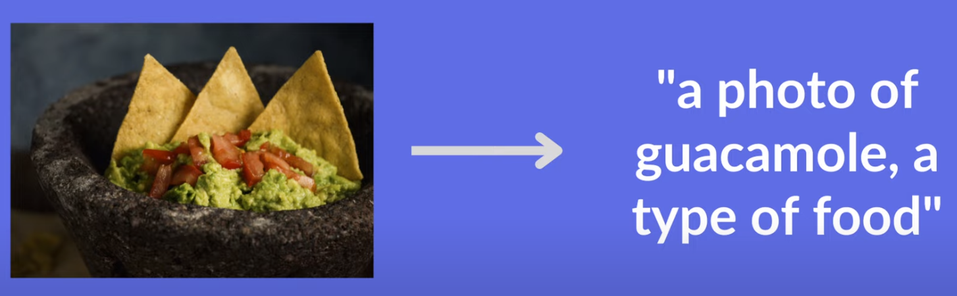
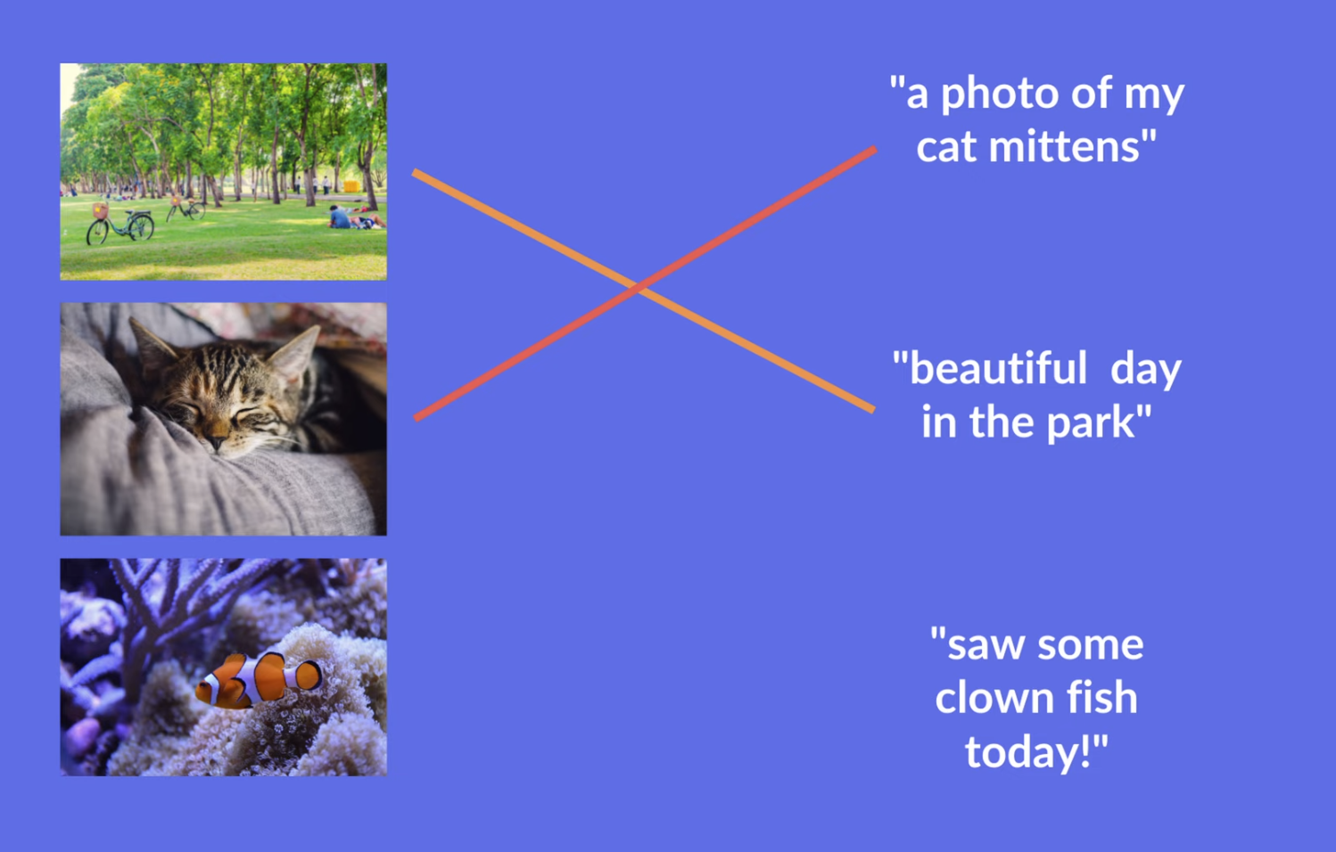
OpenAI CLIP: Revisit
CLIP generated Caption for Images.
Image ⇒ Text is not what we want, but it is still very useful for us because: CLIP is Contrastive Model, which tried to match Image with Text in Latent representation space.
It is trained on pairs of Image and their captions and it tried to match them.

Slide 7

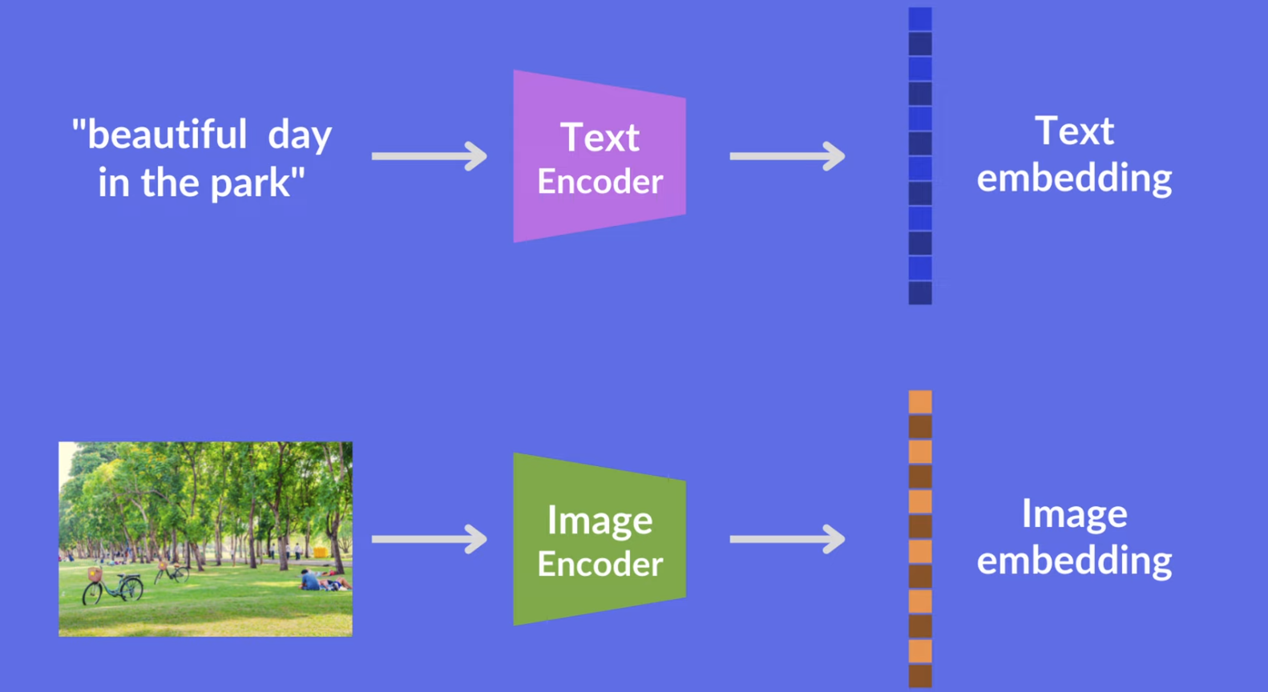
OpenAI CLIP: Revisit
So, when we say, CLIP model is trained, it means: Text and Image Encoders are able to encode Texts and Images into their respective embeddings, where Contrastive Loss is minimized between embeddings.
WHT!! Contrastive Loss!!

Slide 8
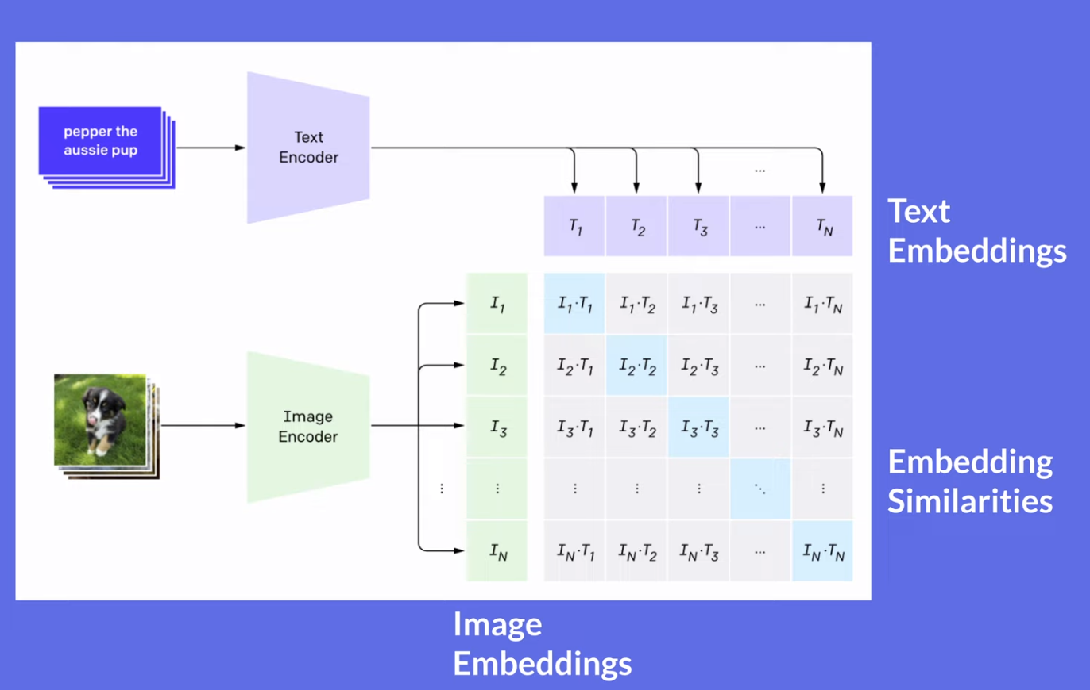
OpenAI CLIP: Contrastive Loss
Contrastive Loss is nothing fancy but: From Sum of all the dot product of all the matching text and Image embedding pairs while subtracting Sum of all the dot product of all the Not matching text and Image embedding pairs.
Maximize: Sum of all the Green Boxed - Sum of all the Gray Boxes

Slide 9
OpenAI CLIP: Train or Use?
CLIP is trained on: LAION-400M: Open Dataset of CLIP-Filtered 400 Million Image-Text Pairs: https://arxiv.org/abs/2111.02114
Systems needed for training a model like these are not an easy commodity.
Cost and Time are of essence in most cases.
So, How to get my share of Text to Image encoding ?
OpenAI provides the text and image encoders of the trained CLIP model to the public.
Available as clip python package: import clip
model, preprocess = clip.load('ViT-B/32', device)
Text and Image Encoders are ready to use as: # Calculate features
model.encode_image(image_input)
model.encode_text(text_inputs)
Dot product of these matching text and image embeddings will be higher than unmatched pair.
Documentation: https://github.com/openai/CLIP

Slide 10
Dall-E2: 1 Ft View
Note: We can directly train the Decoder with Text Embedding, but results are not that great. Authors of the OpenAI have experimented that and found capacity is much better with Prior before training decoder.
DALL-E 2's trained as:
Prior is trained by using Text and Image Embeddings Created by CLIP model.
Decoder is trained by Image Embedding from CLIP and Image itself.
Once, Prior and Decoder is trained, To do Text-to-Image: 1. Get the Text Encoding from Prompt Text. 2. Input Text Embedding to Prior and Get Image Embedding. 3. Generate Image iteratively from Image Embedding using Diffusion Process.

Slide 11
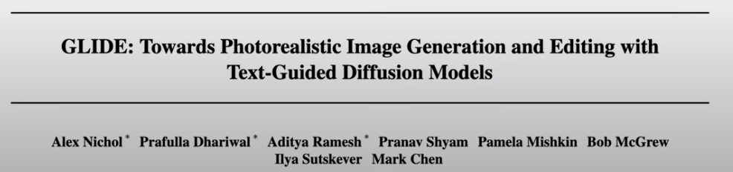
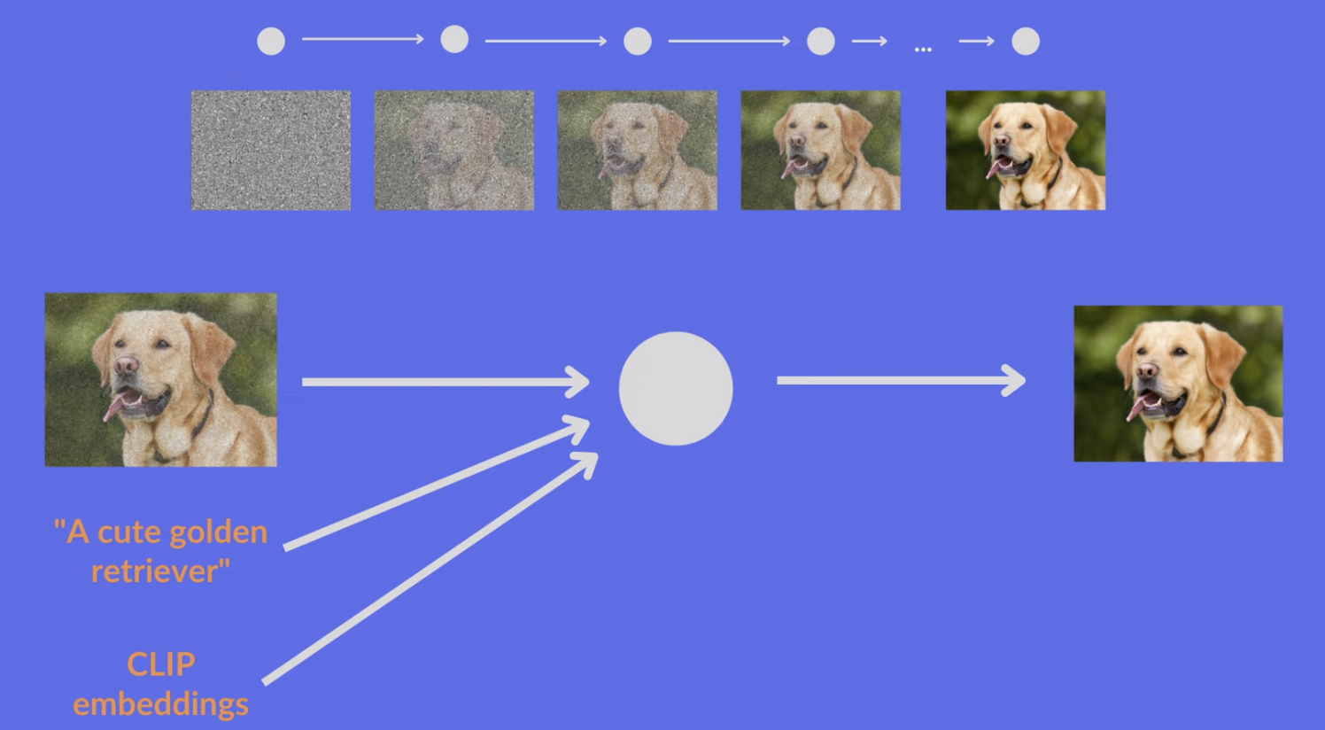
Dall-E2: GLIDE: Decoder Diffusion
Decoder is also a Diffusion model called GLIDE by OpenAI and very much like the DDPM Model. https://arxiv.org/abs/2112.10741
In addition to positional encoding as in DDPM, it take two more inputs other than Image as: CLIP Text Embedding CLIP Image Embedding
Rest of the Diffusion Model Semantics are same as DDPM.
Of Course it has higher number of parameters to learn than DDPM.

Slide 12

Dall-E2: Yay, Let’s Train?
Yes, lets train a Dall-E2 model from scratch: - If we have 1024 TPUv3 - 900K to run this experiment - Time to do few iterations with time and money at hand.
If scenario above is not easily viable, then go for fine-tuning the Open Source Stable Diffusion for our custom Data needs.
This is still a very big deal..!!

Slide 13
Experiments: Use what we learned
With Knowledge of Diffusion Model and CLIP Text and Image Embedding, We can play around with some basic Image generation and get a feel for: CLIP Text Encoders. Hugging Face Spaces. Hugging Face Diffusers Library.
Before fiddling with Code, remember: Latents Text Embedding Image Embedding Diffusion Process across Timestamps
Let’s Go To The RunPod: Module_3_Stable_Diffusion_Deep_Dive.ipynb

Slide 14
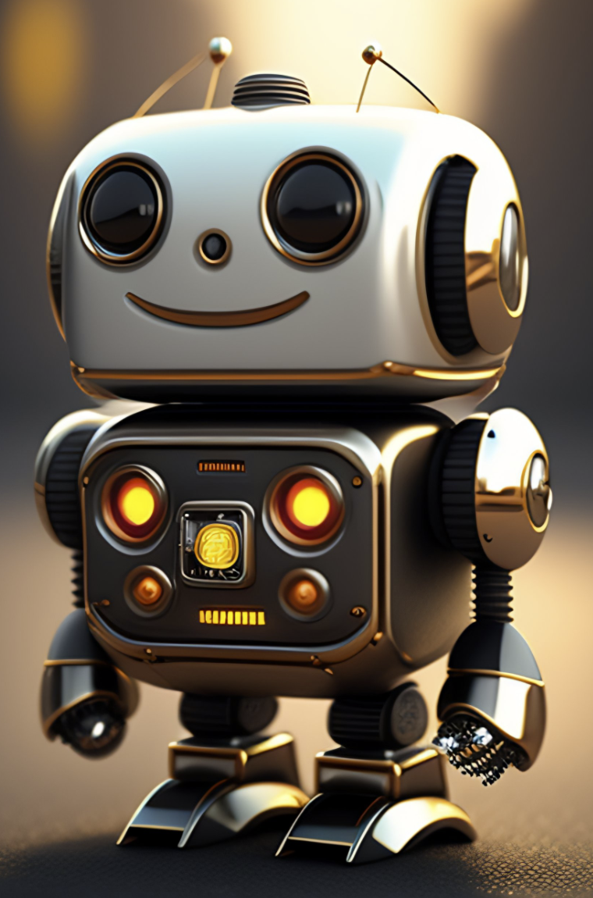
Questions?

Slide 15

!

